Slide 1

Course material on stroke

Slide 2
Om materialet
Dette materiale er udviklet af Dansk Råd for Genoplivning (DRG) og stilles gratis til rådighed for kursusorganisationer, som underviser i førstehjælpskurser o.lign. for voksne, og som ønsker at inkludere stroke i kursusmaterialet til instruktørerne. Denne version er oversat til engelsk.
I er velkomne til at plukke i materialet og indsætte eget logo ved siden af DRGs.

Slide 3
About stroke
The fourth most common cause of death in Denmark and the most common cause of acquired disability in adults.
85% of strokes are caused by a blood clot occluding a brain artery, while 15% are due to a brain hemorrhage.
Stroke is an emergency. Every minute counts.
Fast treatment reduce the brain damage caused by the stroke and improve outcomes.
A stroke rarely causes pain but can result in a sudden loss of function. It is important to react quickly and call 1-1-2 (in Denmark).

Slide 4
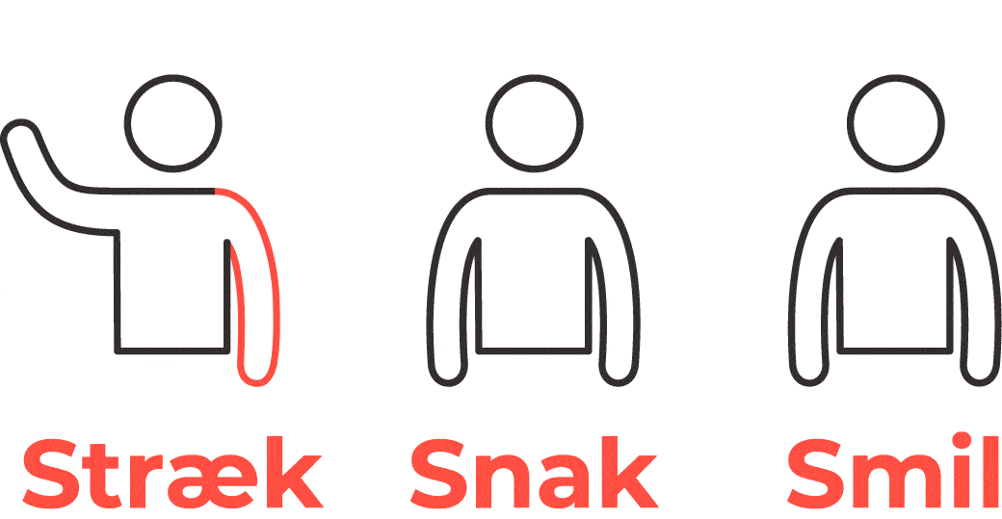
Signs of stroke
Arm Weakness: Is one arm weak, dyscoordinated or numb? Ask the person to raise both arms. Does one arm drift downward?
Speech Difficulty: Is speech slurred or disturbed?
Face Drooping: Does one side of the face droop or is it numb? Ask the person to smile. Is the person's smile uneven?
Call 1-1-2 (in Denmark) immediately if any of these signs of stroke appear

